Slide 1
IBNN
Journey through the Check24 challenge in hackaTUM-24

Slide 2
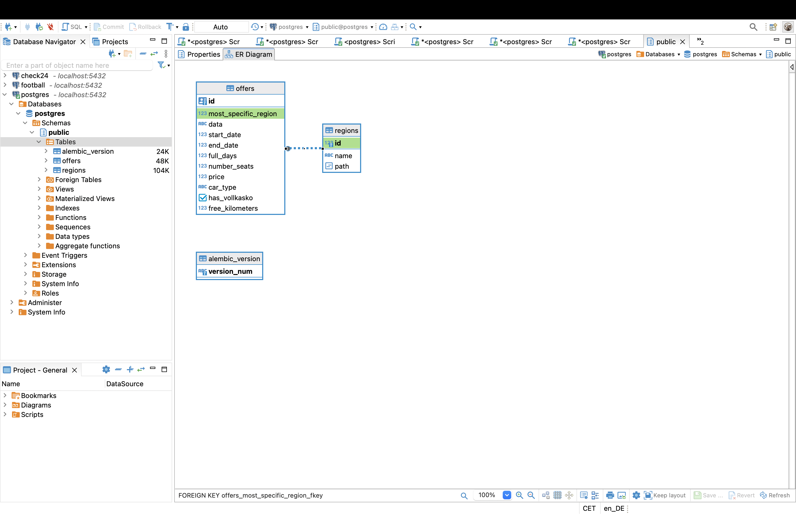
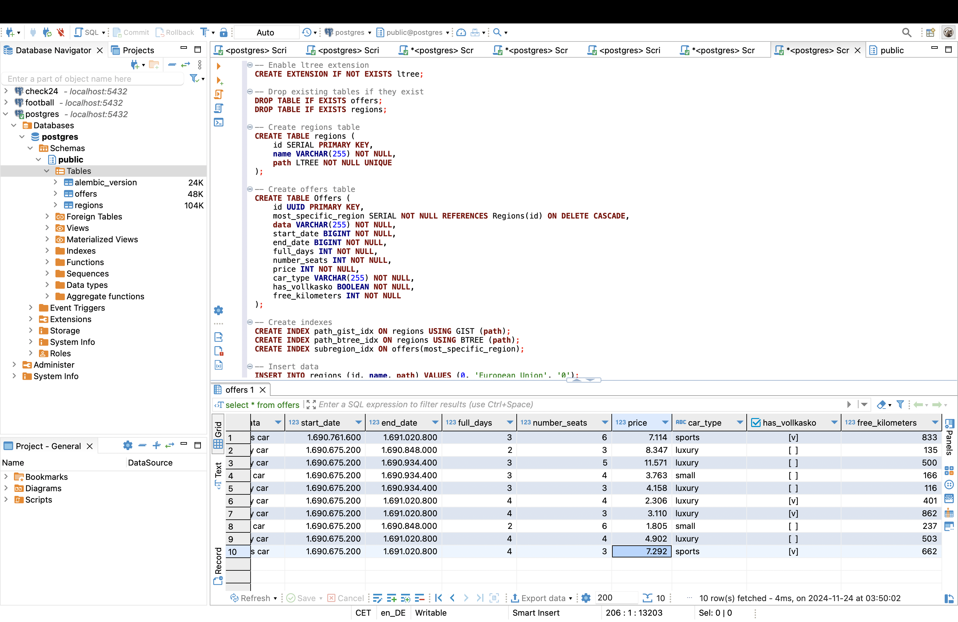
Database

Slide 3
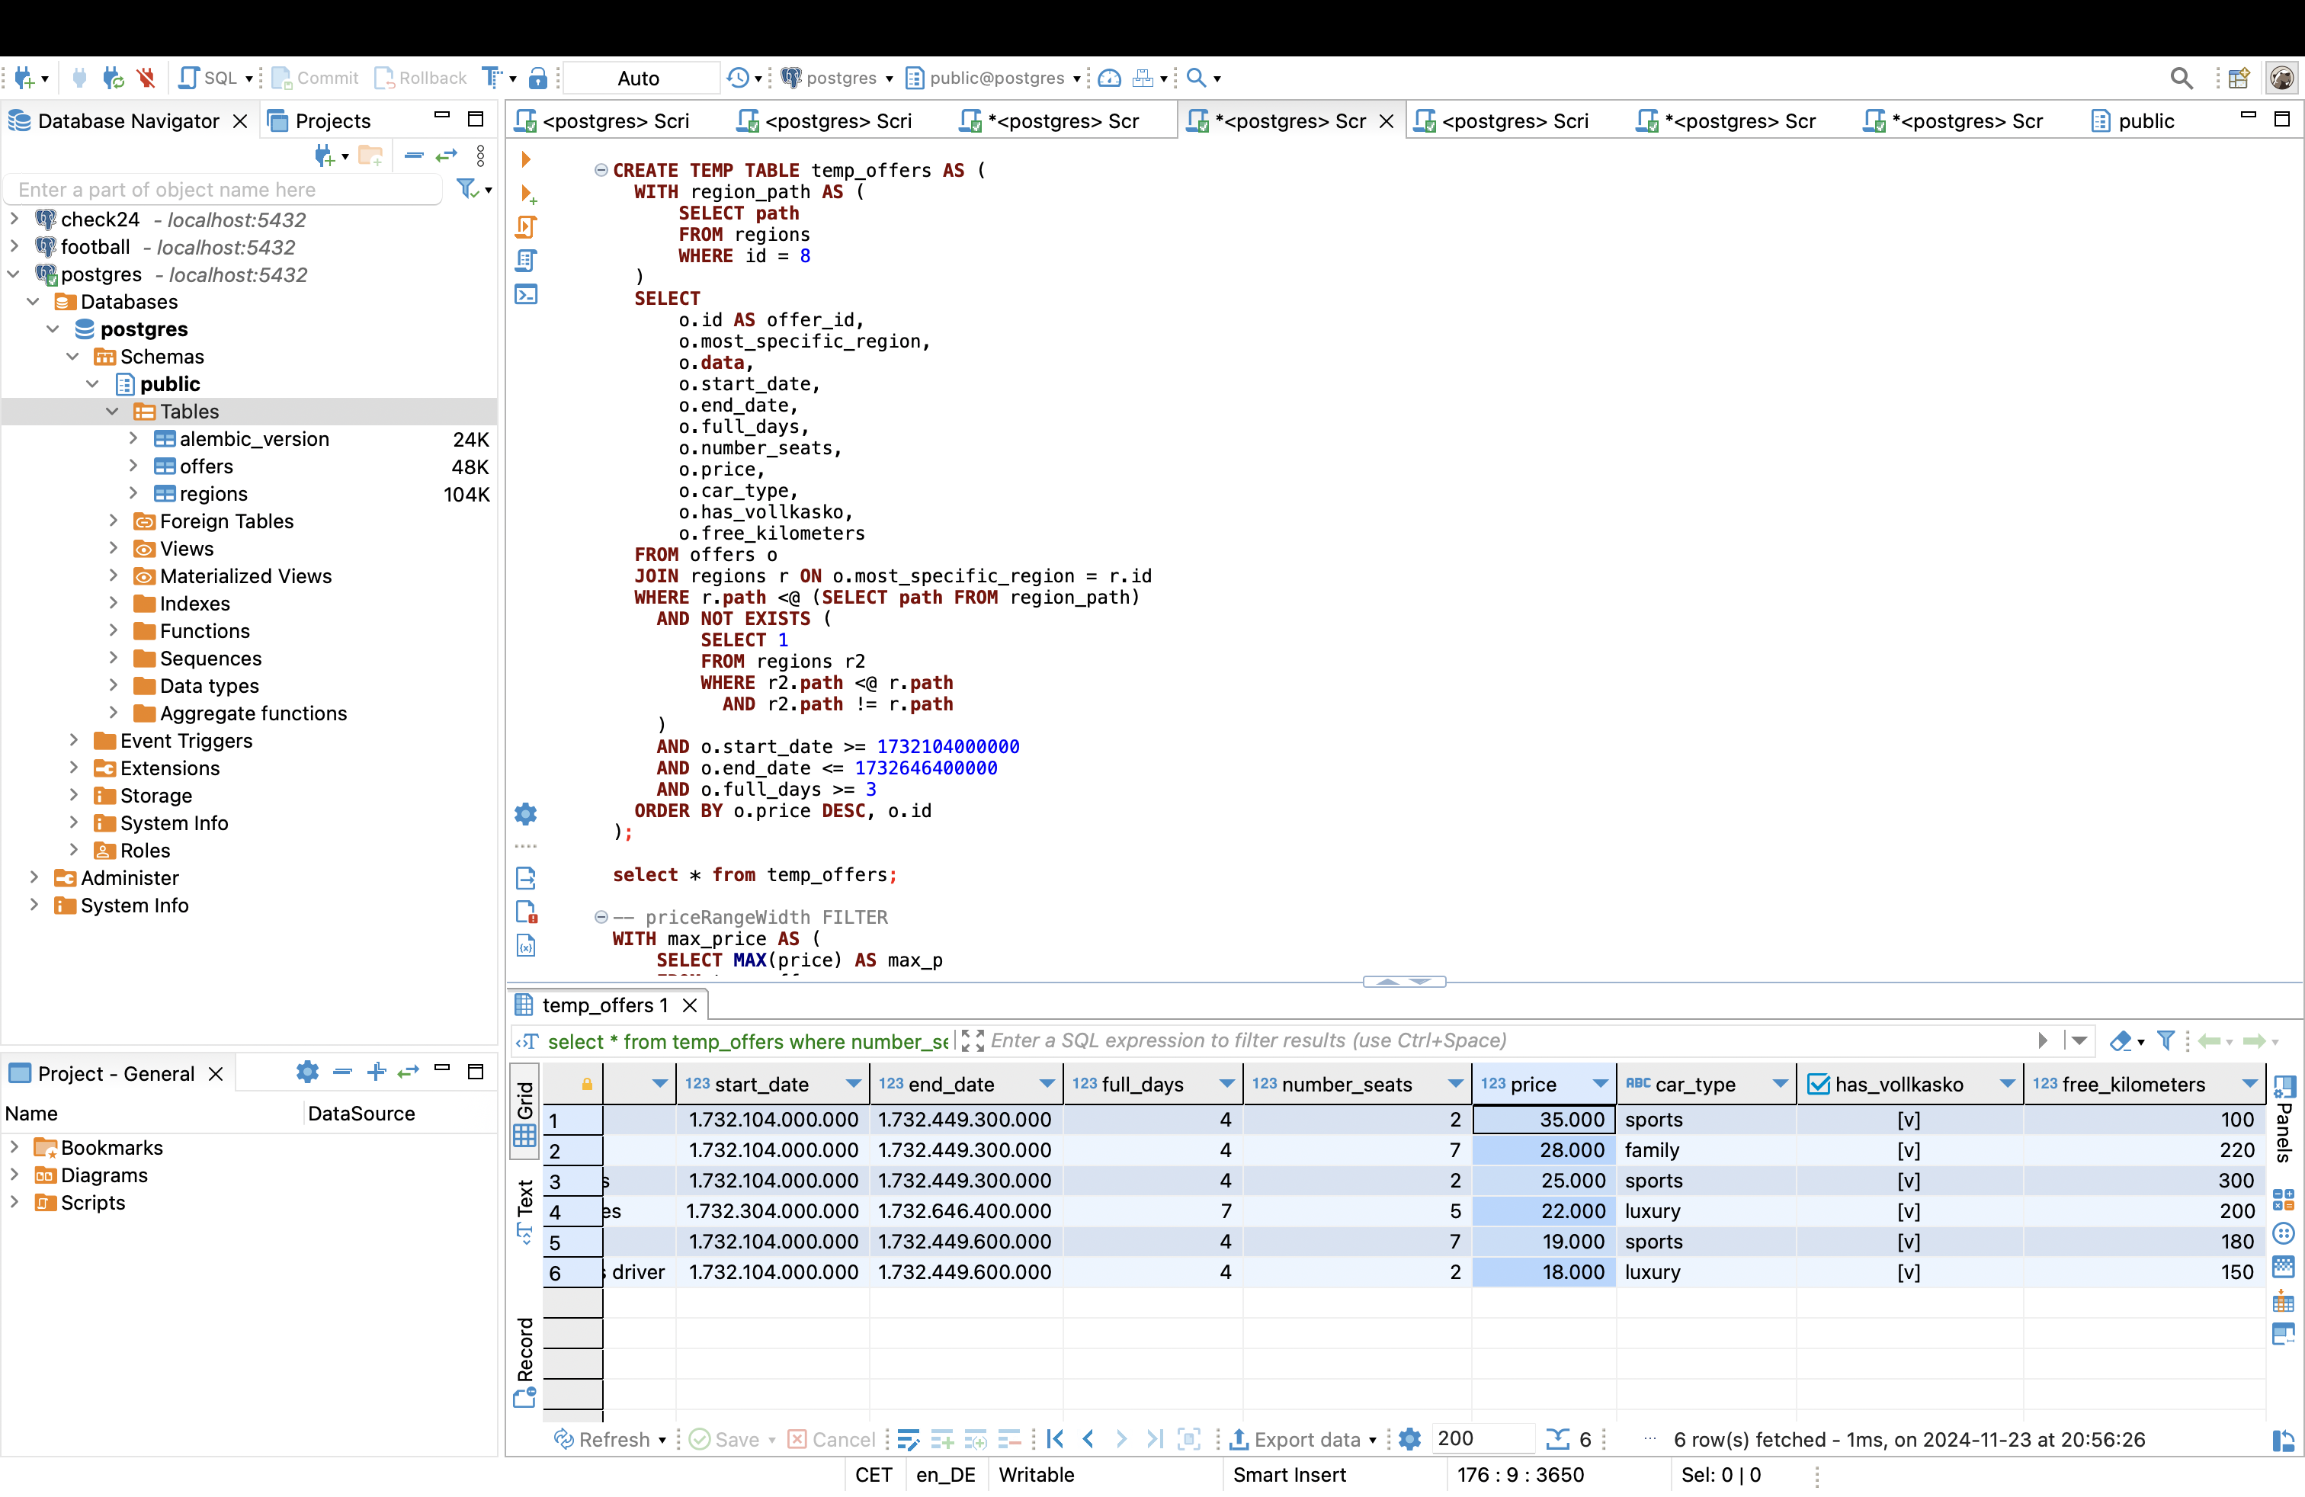
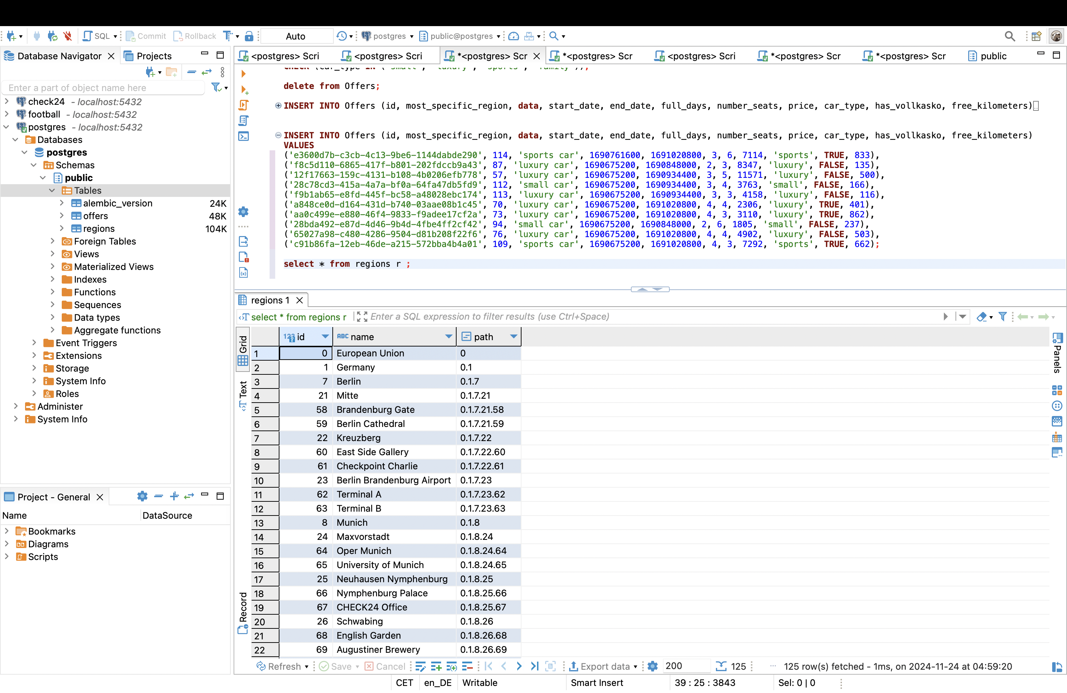
PostgreSQL Ltree

Slide 4
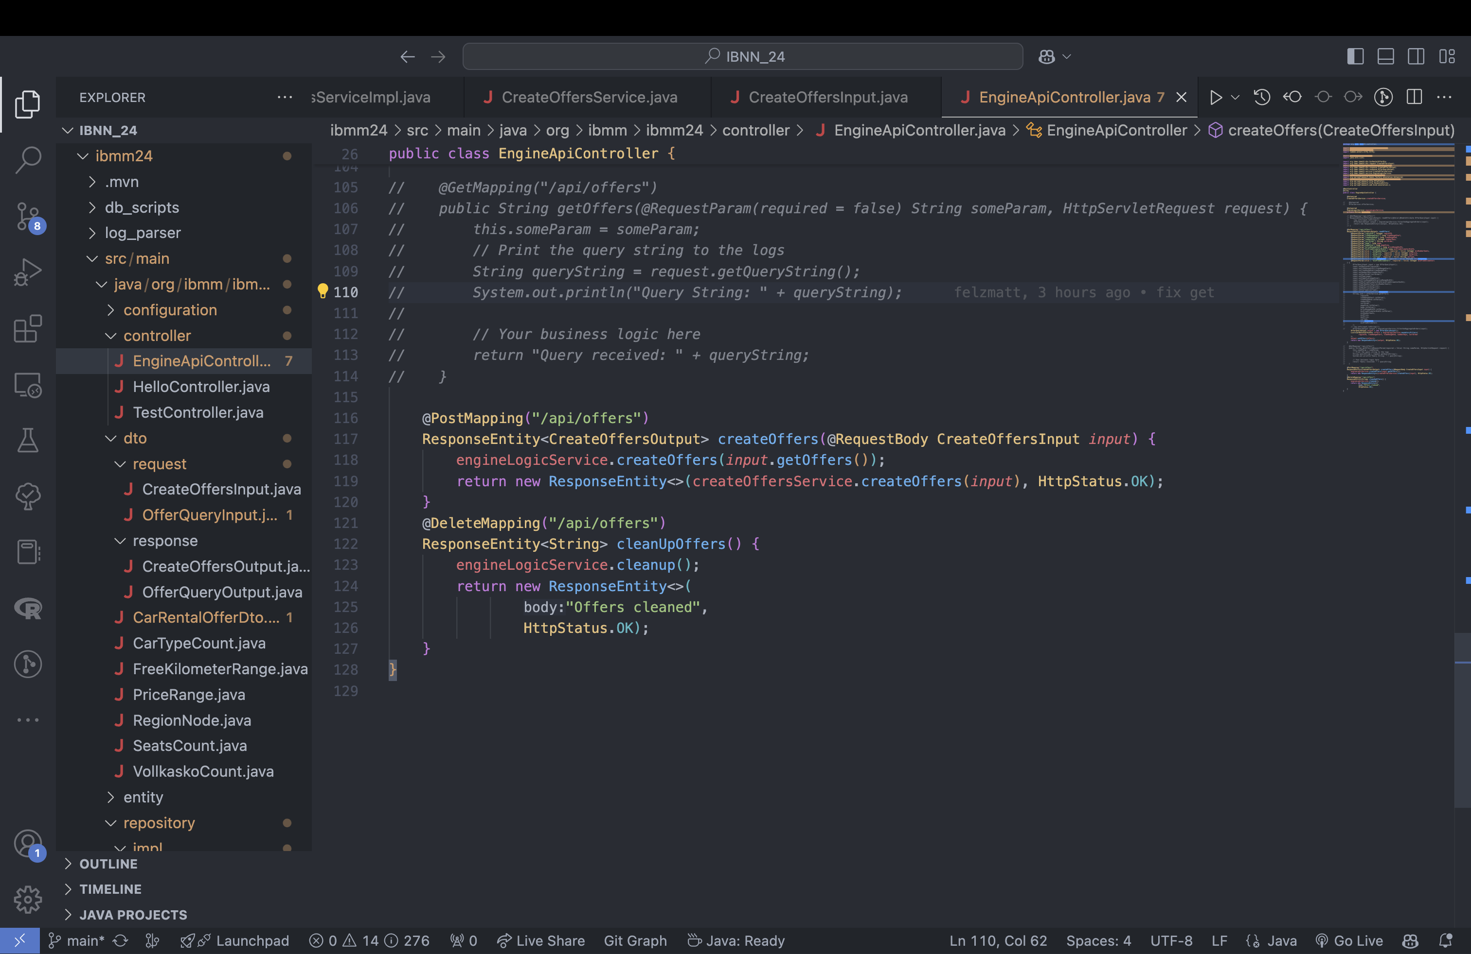
DELETE

Slide 5
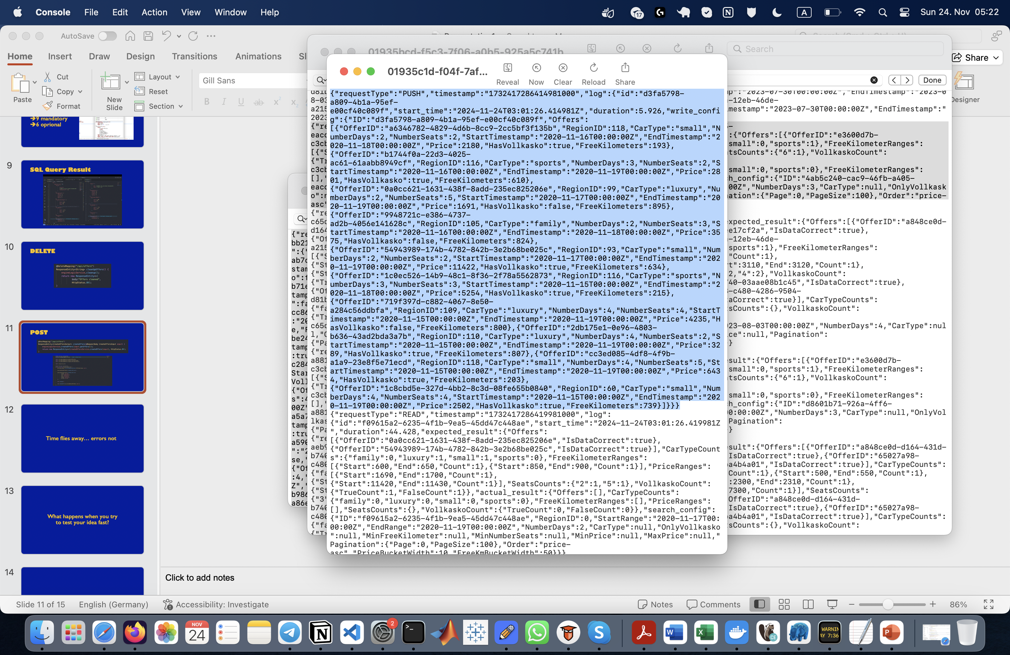
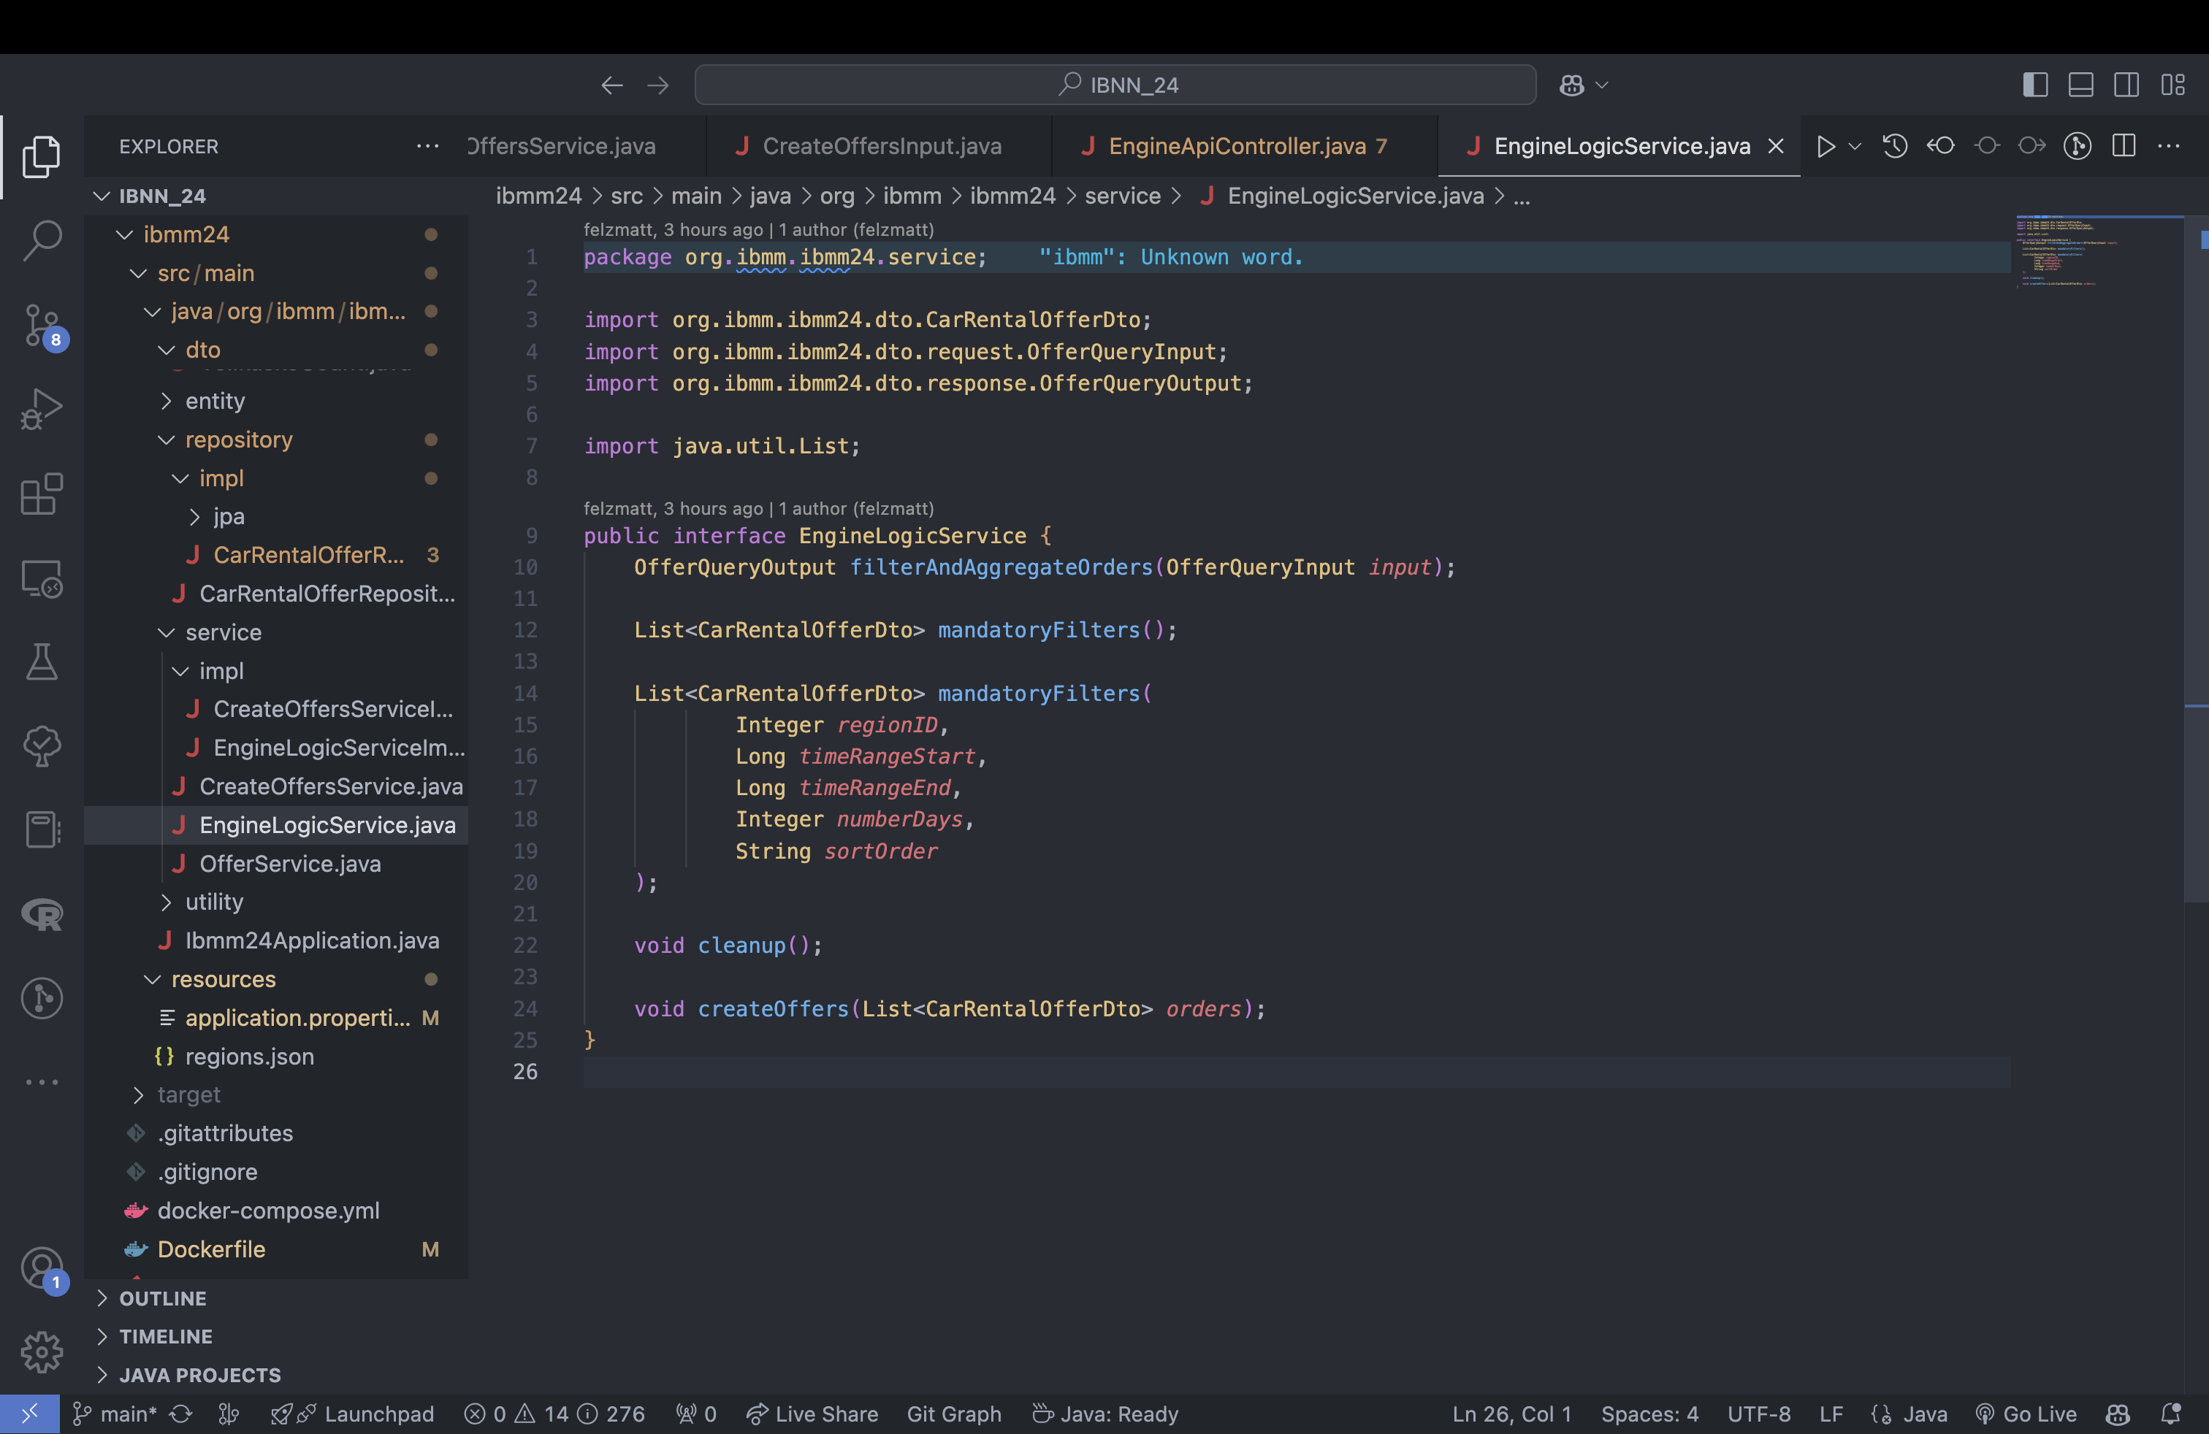
POST

Slide 6
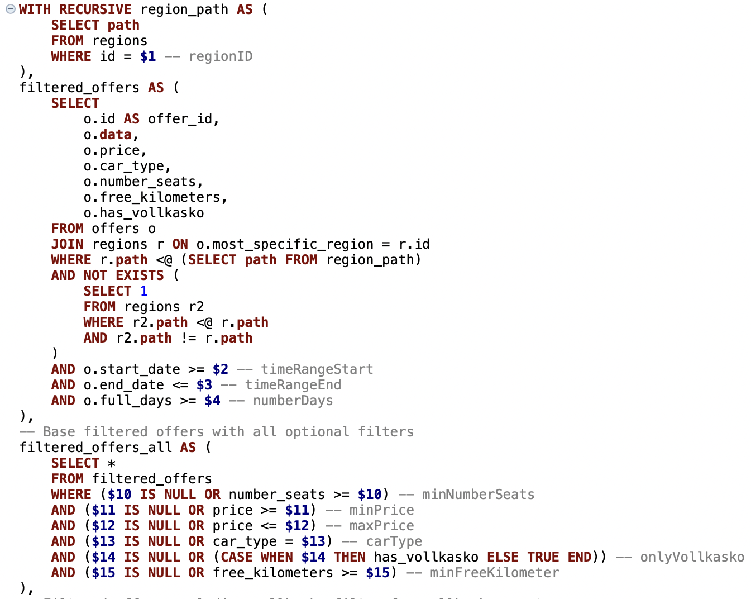
Filtering
1. Apply mandatory filters

Slide 7
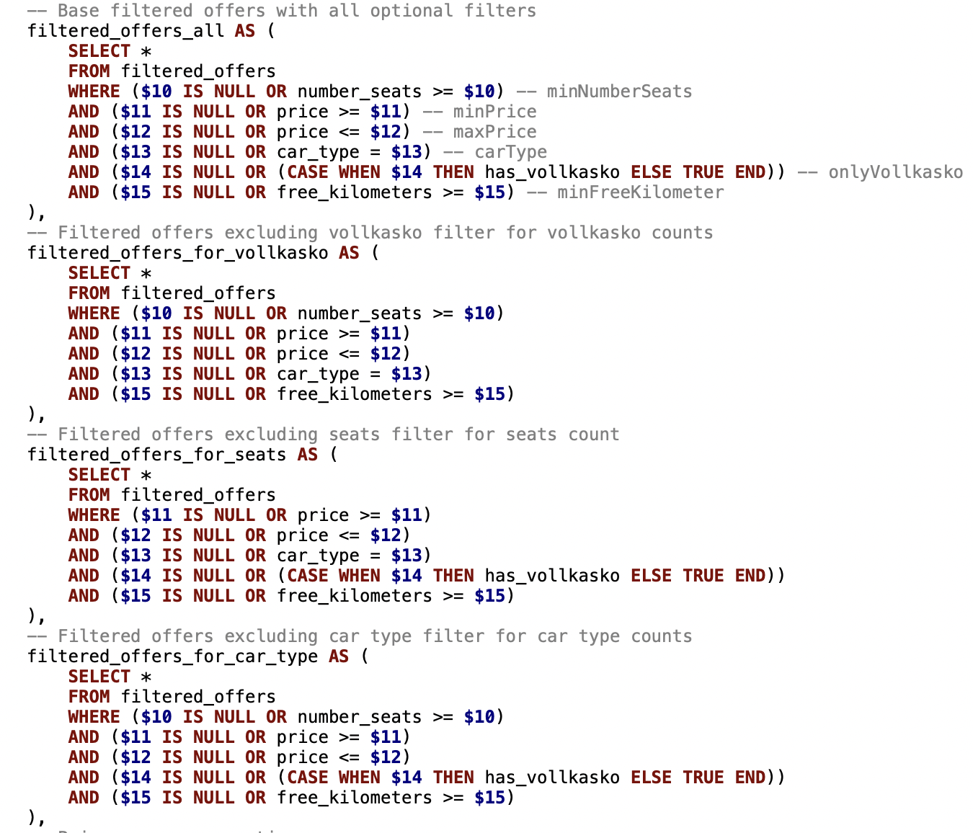
Filtering
2. For each filter apply all filters except self

Slide 8
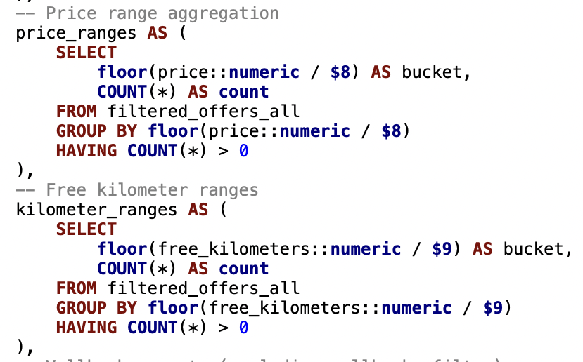
Filtering
3. Perform range calculations

Slide 9
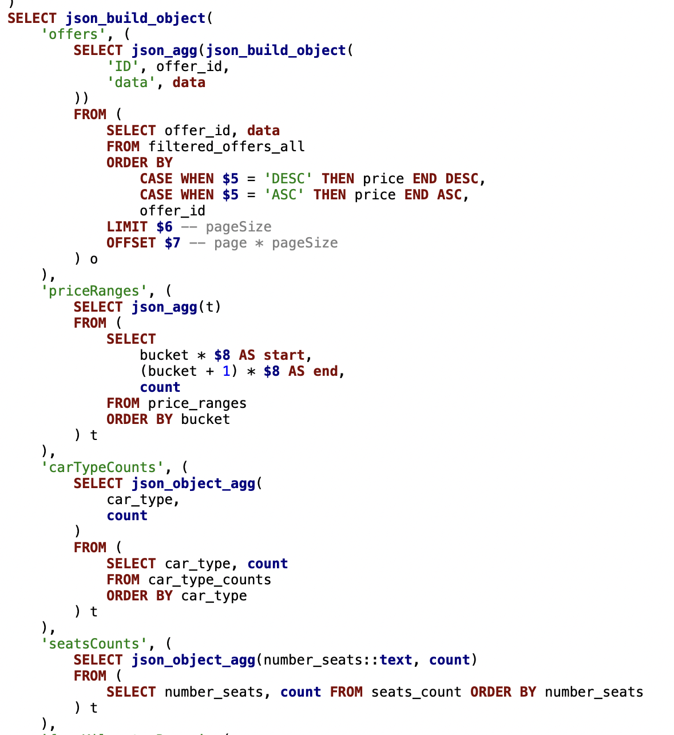
Filtering
4. Apply aggregations and build the result

Slide 10
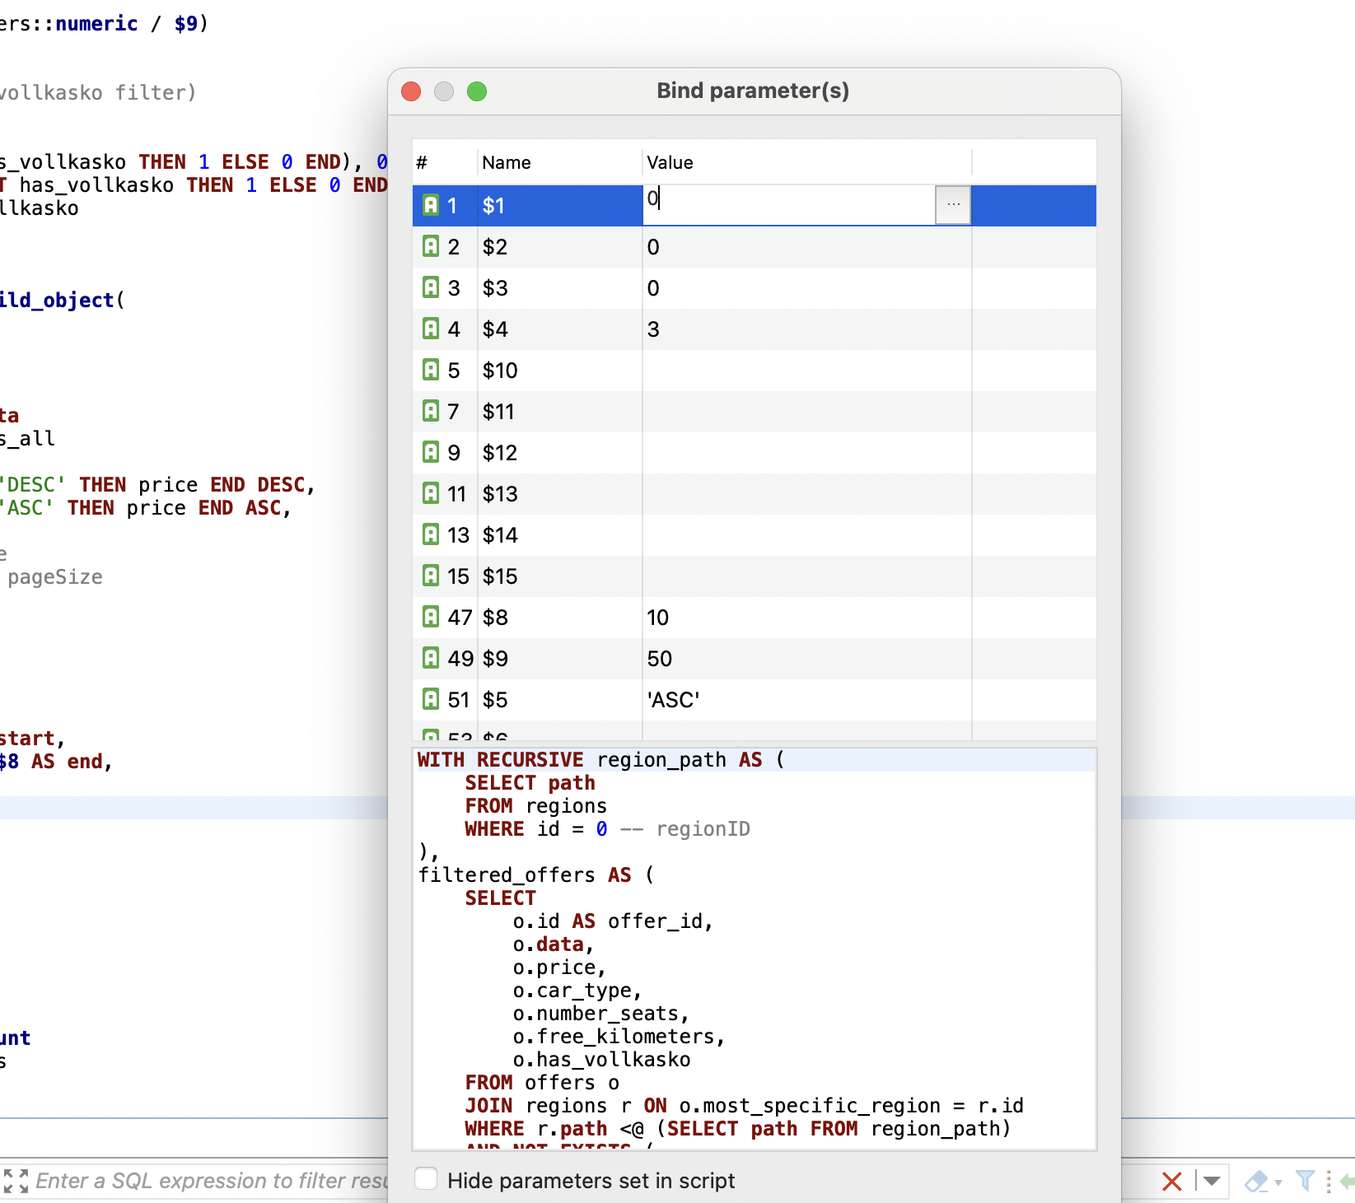
Filtering
One query
9 mandatory
6 oprional

Slide 11
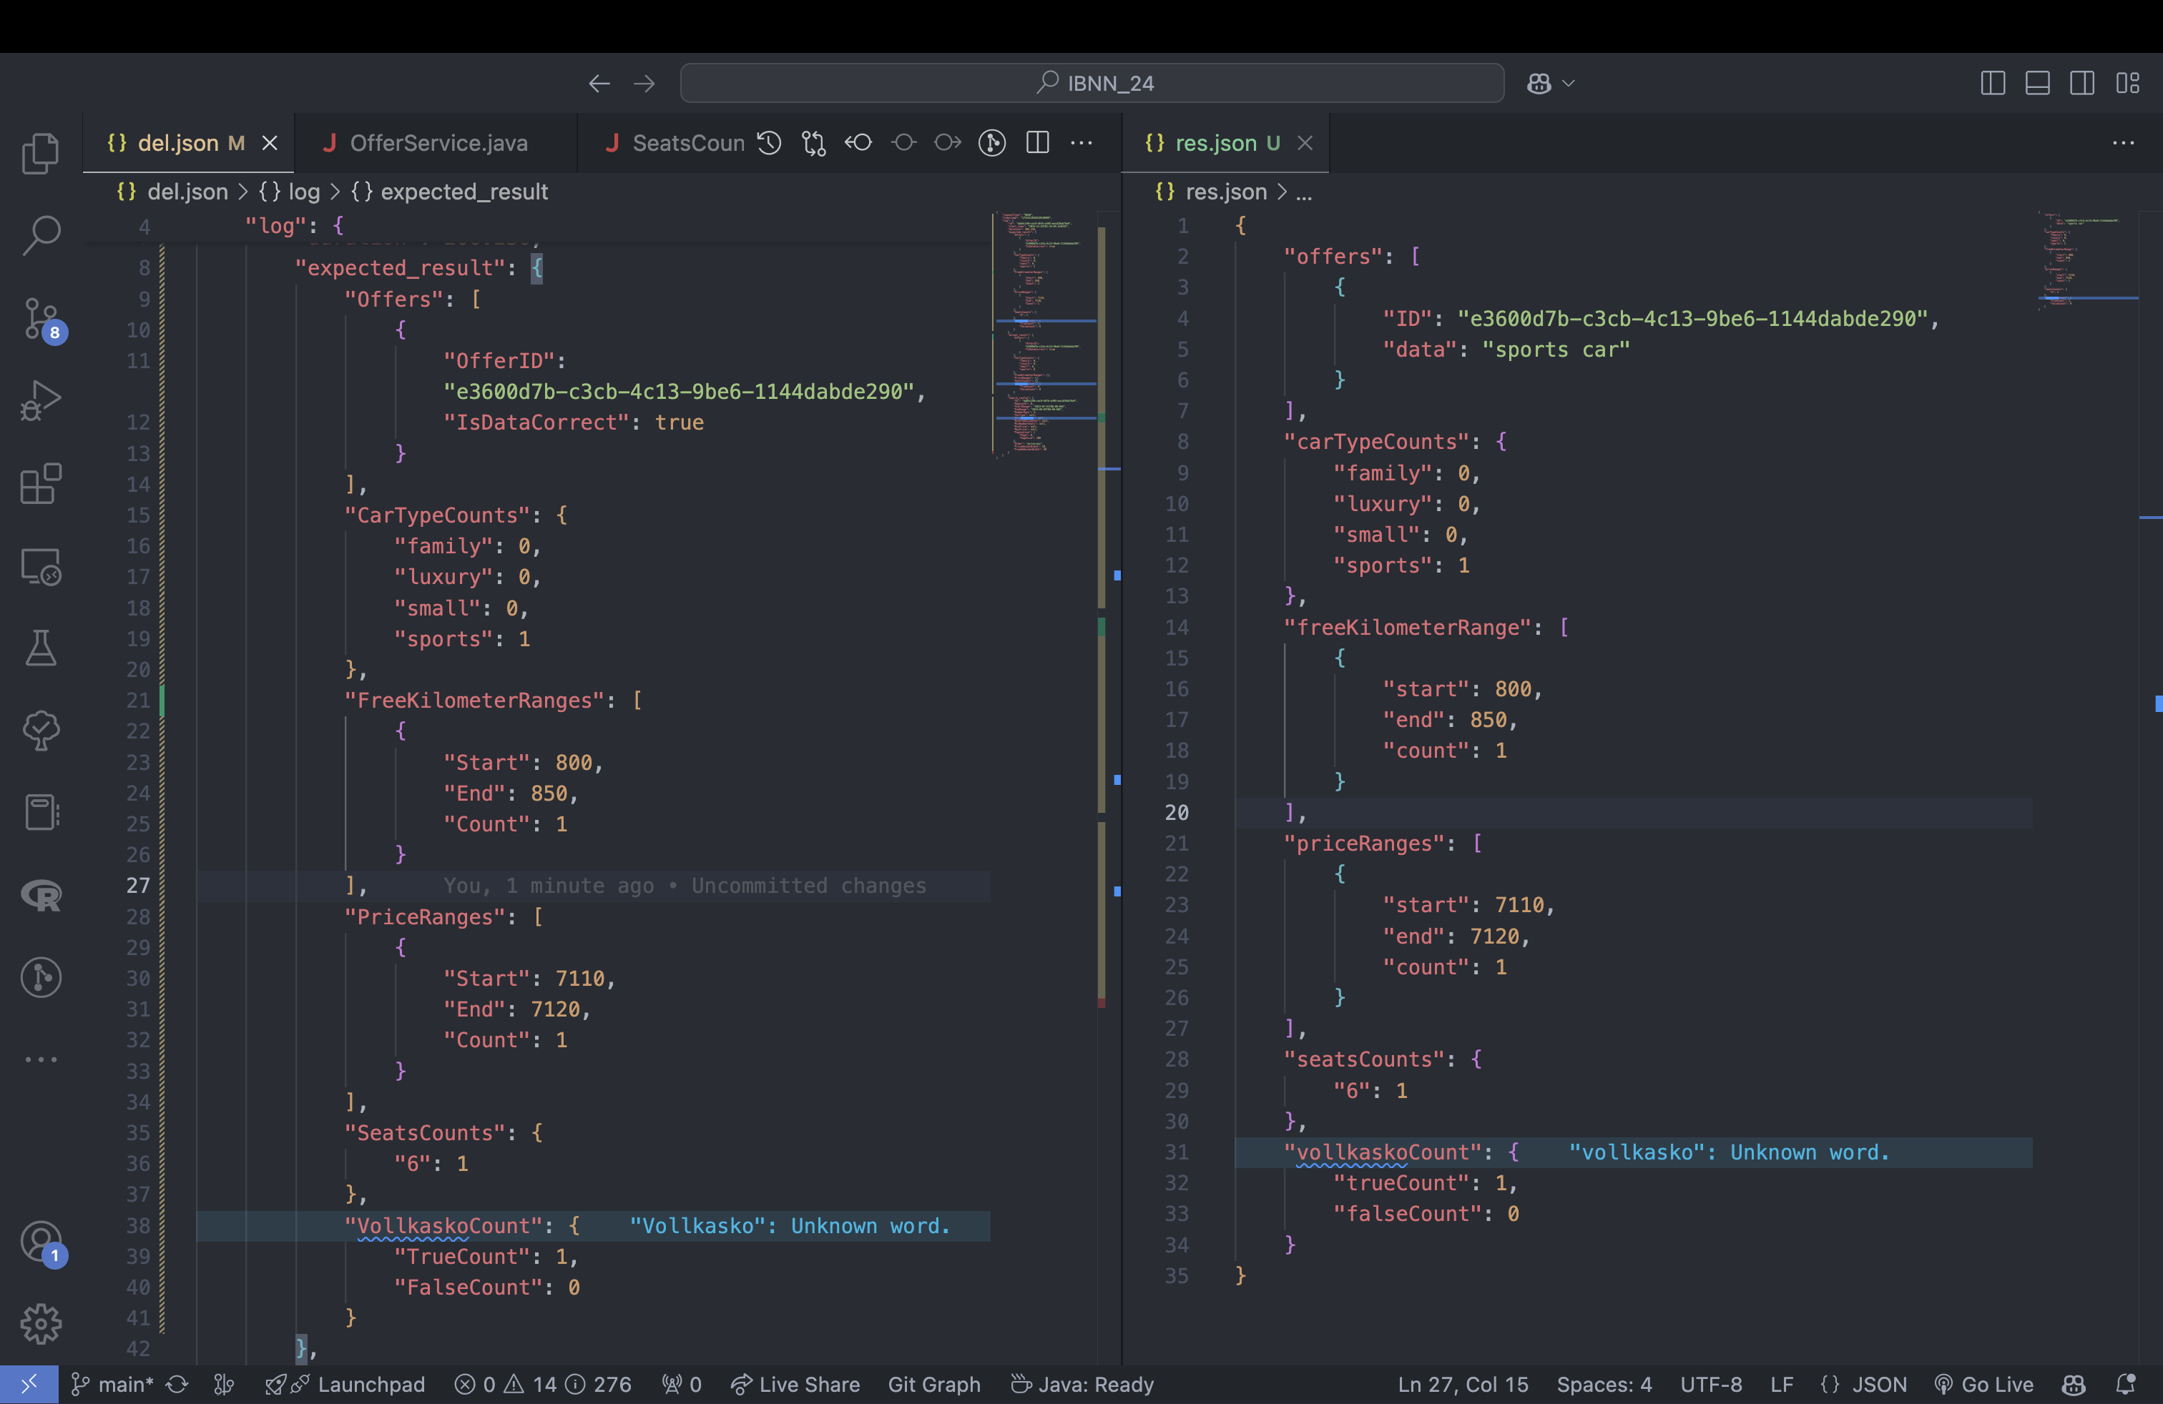
SQL Filtering Test

Slide 12
Time flies away… errors not

Slide 13
What happens when you try to test your idea fast?

Slide 14
Simple Code
Crappy Code

Slide 15
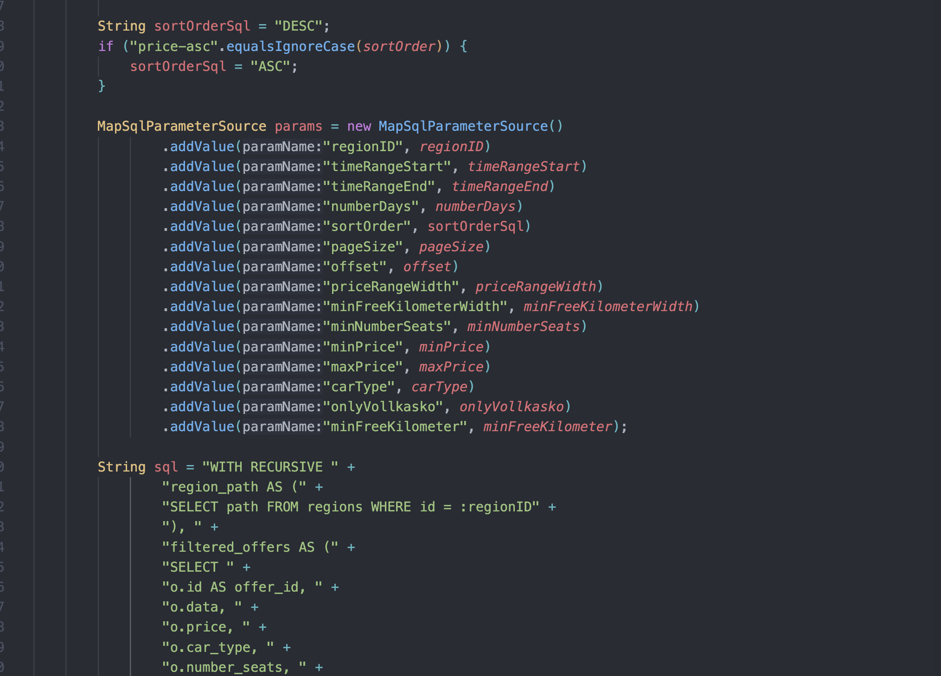
Let’s do Strings

Slide 16
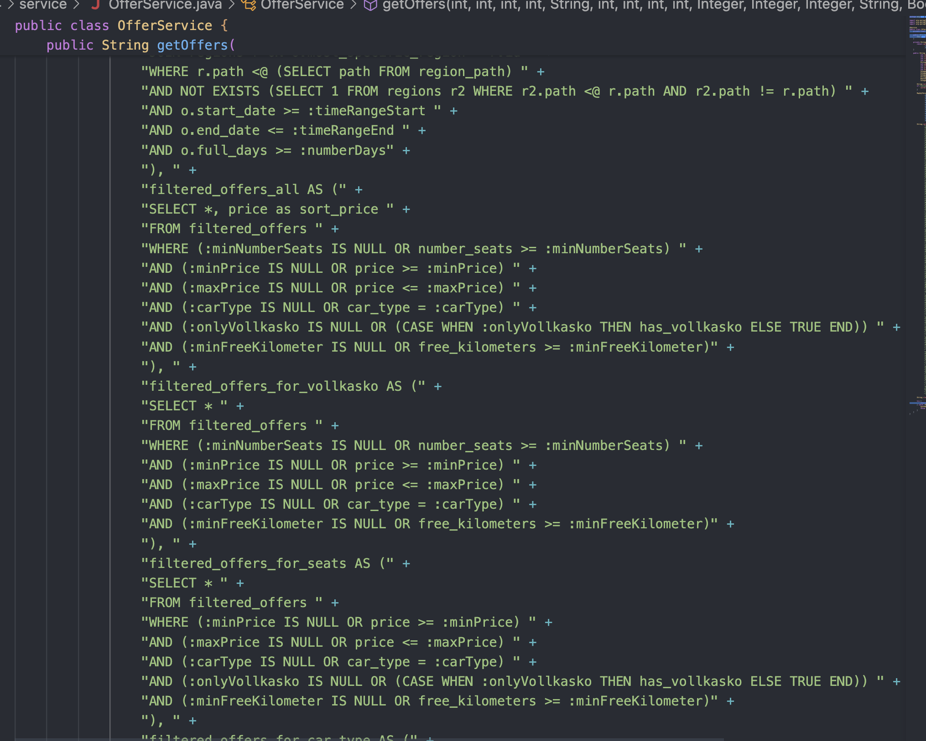
Longer Strings

Slide 17
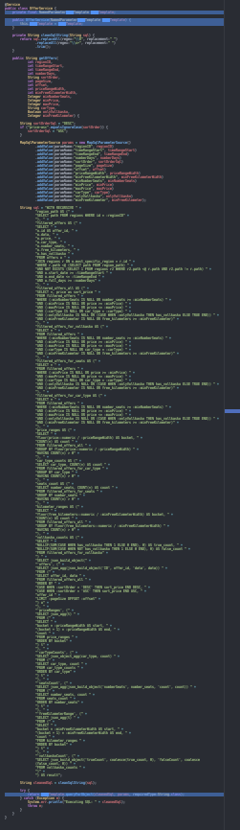
Very Long Strings

Slide 18
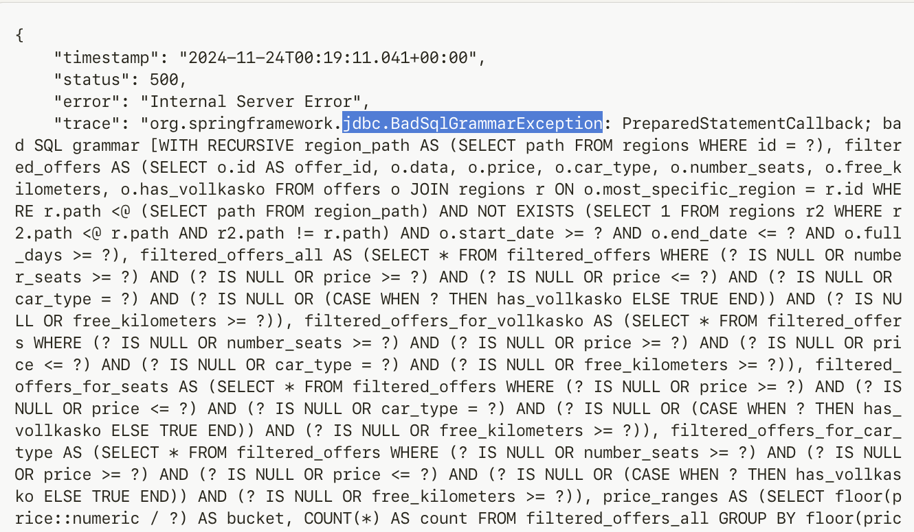
Spoiler: bad idea…

Slide 19


Challenges

Slide 20
The End

